Slide 1
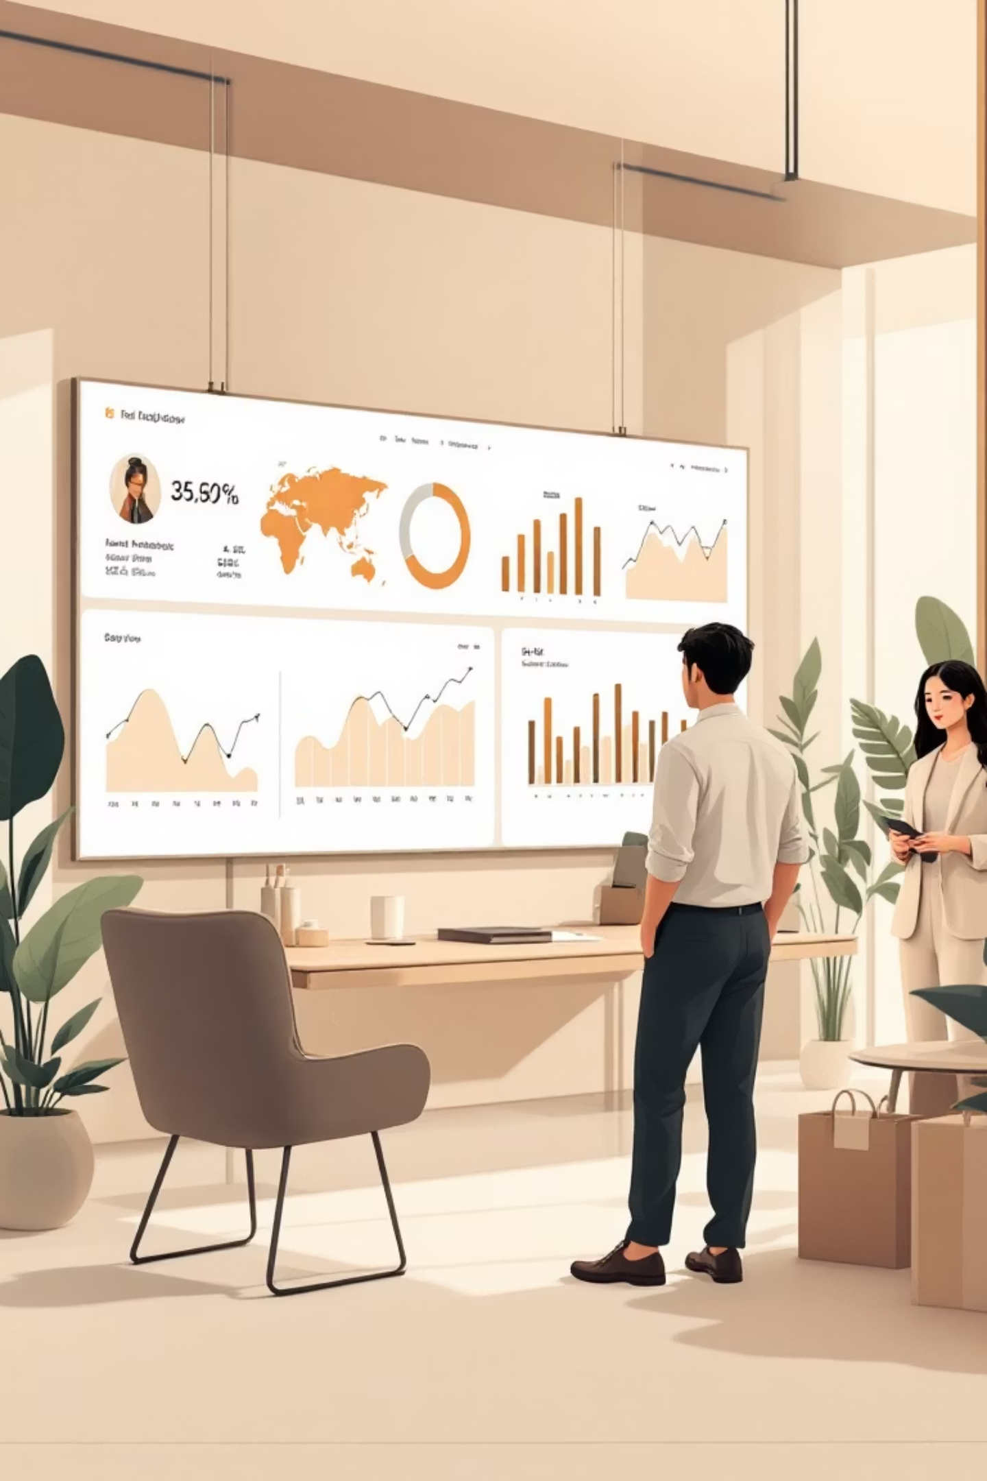
Customer Shopping Behavior Analysis
Uncovering insights from 3,900 purchases to drive strategic business decisions

Slide 2
DATASET OVERVIEW
Understanding Our Data Foundation
3,900
18
4
50
Total Purchases
Data Points
Product Categories
Locations
Comprehensive transaction records analyzed
Key features per customer transaction
Clothing, Accessories, Footwear, Outerwear
Geographic distribution across regions
Dataset includes customer demographics, purchase details, shopping behavior patterns, and subscription status with minimal missing data (37 values in Review Rating).

Slide 3


PYTHON ANALYSIS
Data Preparation & Engineering
01
Data Loading & Exploration
Imported dataset using pandas, analyzed structure with df.info() and summary statistics
02
Data Cleaning
Imputed missing Review Rating values using median by category, standardized columns to snake case
03
Feature Engineering
Created age_group bins and purchase_frequency_days for deeper analysis
04
Database Integration
Connected to PostgreSQL and loaded cleaned data for SQL analysis

Slide 4
SQL INSIGHTS
Key Business Findings
Revenue by Gender
High-Value Discount Users
Male customers generated $157,890 compared to female customers at $75,191 — a significant revenue gap to address.
839 customers used discounts but still spent above average, indicating smart promotional targeting.
Top-Rated Products
Shipping Preferences
Gloves: 3.86 rating
Express shipping users spend $60.48 on average vs. $58.46 for Standard — premium service attracts higher spenders.
Sandals: 3.84 rating
Boots: 3.82 rating

Slide 5


Subscription Analysis
27%
73%
Subscription Rate
Non-Subscribers
1,053 subscribers out of 3,900 customers
2,847 customers without subscriptions
Subscribers and non-subscribers show similar average spending patterns ($59.49 vs. $59.87), but non-subscribers drive significantly higher total revenue due to volume.
Opportunity: Converting non-subscribers could unlock substantial revenue growth.

Slide 6




CUSTOMER SEGMENTATION
Understanding Customer Loyalty
New (83)
Returning (701)
Loyal (3,116)
Our customer base is dominated by loyal customers (80%), indicating strong retention. However, repeat buyers with 5+ purchases show mixed subscription adoption — 958 are subscribers while 2,518 are not.
Focus on converting high-frequency purchasers into subscribers to maximize lifetime value.

Slide 7
Product Performance Insights
Clothing Category
Accessories
Footwear
Outerwear
Top sellers: Blouse (171), Pants (171), Shirt (169)
Top sellers: Jewelry (171), Sunglasses (161), Belt (161)
Top sellers: Sandals (160), Shoes (150), Sneakers (145)
Top sellers: Jacket (163), Coat (161)

Slide 8
DISCOUNT STRATEGY
Discount-Dependent Products
50%
49.66%
49.07%
Hat
Sneakers
Coat
48.17%
47.37%
Sweater
Pants
Nearly half of all purchases for these products involve discounts. This presents both an opportunity and a risk — while discounts drive volume, they may be eroding margins unnecessarily.

Slide 9
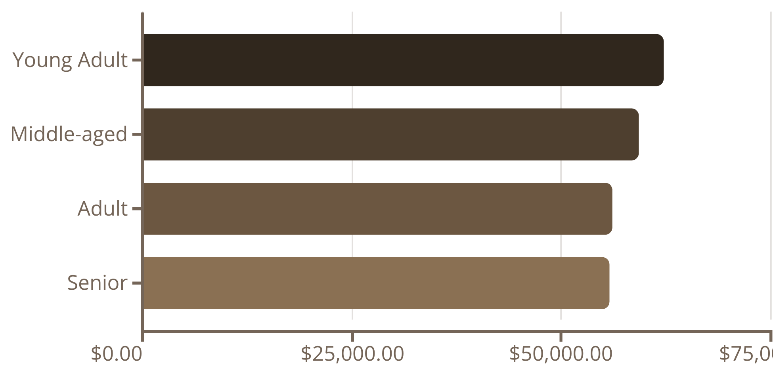
Revenue Distribution by Age
Young adults lead revenue generation, contributing over $62,000. Revenue is relatively balanced across age groups, suggesting broad market appeal.
Average Review Rating: 3.75/5.0
Consistent satisfaction across demographics indicates product quality meets expectations.
Average purchase amount across all segments: $59.54

Slide 10




ACTION PLAN
Strategic Recommendations
Boost Subscriptions
Promote exclusive benefits and rewards to convert high-frequency buyers into subscribers
Loyalty Programs
Reward repeat buyers to accelerate movement into the loyal customer segment
Optimize Discounts
Review discount policy to balance sales growth with margin protection
Product Positioning
Highlight top-rated products (Gloves, Sandals, Boots) and best-sellers in marketing campaigns
Targeted Marketing
Focus on high-revenue age groups (Young Adults) and premium service users (Express shipping)

